Slide 1
Problem Solving and Python Programming
Rajasekaran S
Assistant Professor,
Department of Information Technology,
KGiSL Institute of Technology,
email: proffraja@gmail.com
Github:www.github.com/rajasekaranap

Slide 2
Finding Minimum in the List
7
5
2
1
8
9
need to find the minimum
7
5
2
1
8
9
Assume first element is minimum
Min = 7
7
5
2
1
8
9
Compare min with current element
If it greater than or equal to current set min as current element
Min = 7
Current 5
Min>Current -> Min = Current ->Min = 5
7
5
2
1
8
9
Min = 5
After comparison
Min = 2

Slide 3
Finding Minimum in the List
7
5
2
1
8
9
Min = 2
After comparison
Min = 1
7
5
2
1
8
9
Min = 1
After comparison
Min = 1
7
5
2
1
8
9
Min = 1
After comparison
Min = 1
7
5
2
1
8
9
Min
Then there is no element to compare
Print minimum as current min

Slide 4
Finding Minimum in the List [Algorithm]
Step 1 | Start Process
Step 2 | Generate a list of 6 random numbers and store in mylist
Step 3 | Assign length _of_list as 6
Step 4 | Initialize i as 1 and min as first element of mylist
Step 5 | Get mylist[i] and store in current_element
Step 6 | If current_element is less than or equal to min then assign min as current element
Step 7 | Else do nothing
Step 8 | Increment i value by 1
Step 9 | If i value is equal to length_of_list goto Step 11
Step 10 | Else goto Step 5
Step 11 | Display minimum as min
Step 12 | Stop Process

Slide 5
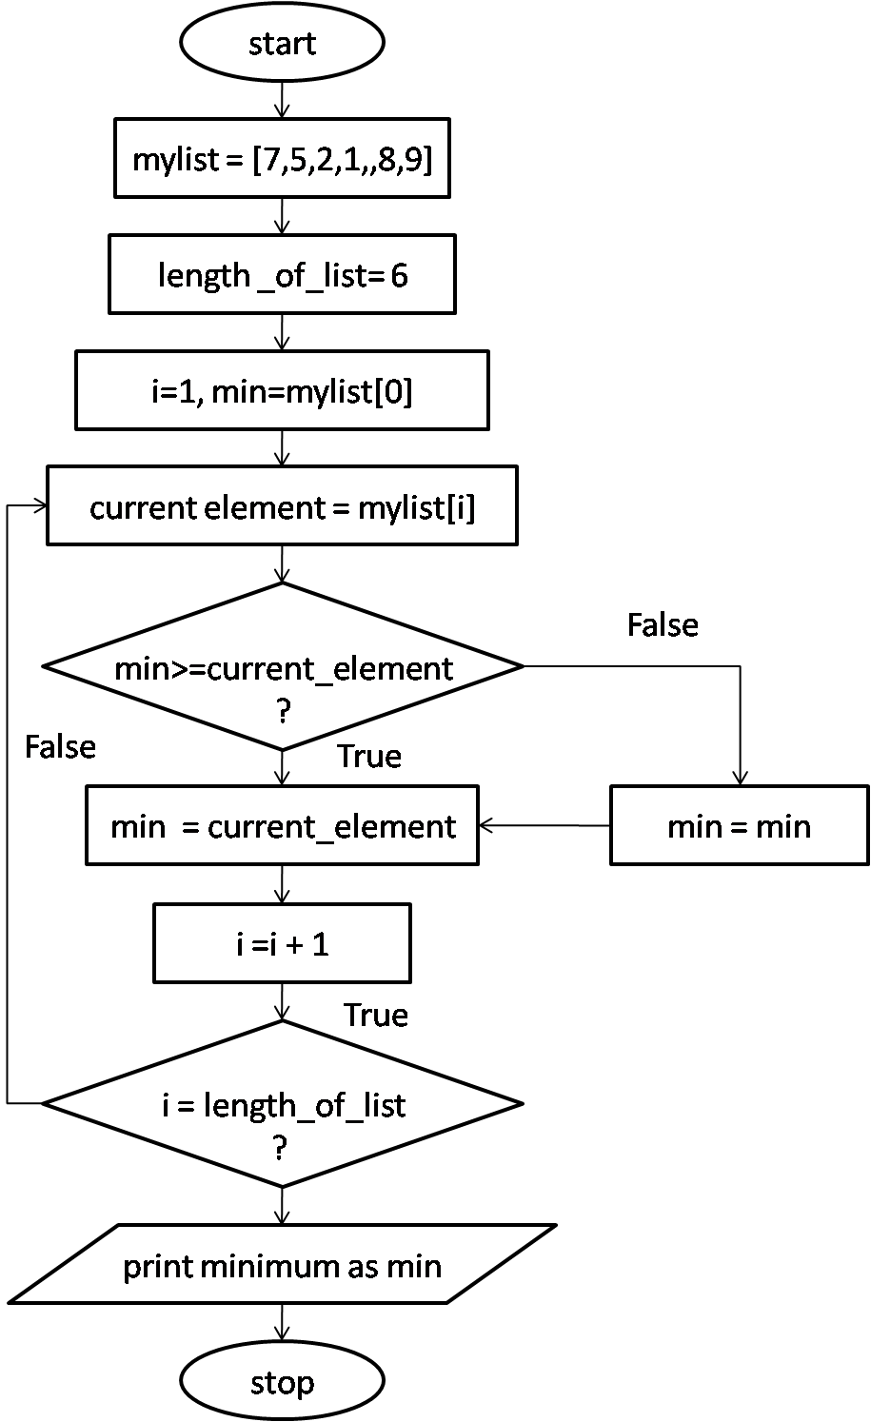
Finding Minimum in the List [Flowchart]

Slide 6
Finding Minimum in the List [Pseudo Code]
START
SET mylist = [7,5,2,1,8,9]
SET length_of_list = 6
SET min = mylist[0]
SET i = 1
SET current_element = mylist[i]
WHILE i is less than length_of_list
IF current_element is greater than or equal to min
min = current_element
ELSE
min = min
END IF
END WHILE
PRINT “Minimum in the mylist is ” min
STOP

Slide 7
Inserting Card in list of sorted cards

Slide 8
Guessing an Integer Number in Range
START
SET actual = 30
PRINT “Enter any number”
READ number
WHILE number not equal to actual
IF number < actual THEN
PRINT “Try some higher number”
ELSE
PRINT “Try some lower number”
END IF
PRINT “Enter any number”
READ number
END WHILE
PRINT “You have found the number !!!”
STOP

Slide 9
Thank You
Rajasekaran S
Assistant Professor,
Department of Information Technology,
KGiSL Institute of Technology,
email: proffraja@gmail.com
Github:www.github.com/rajasekaranap

